Slide 1

10 Opinions For Creating More Maintainable .NET Apps
Slides up at scottsauber.com
scottsauber

Slide 2
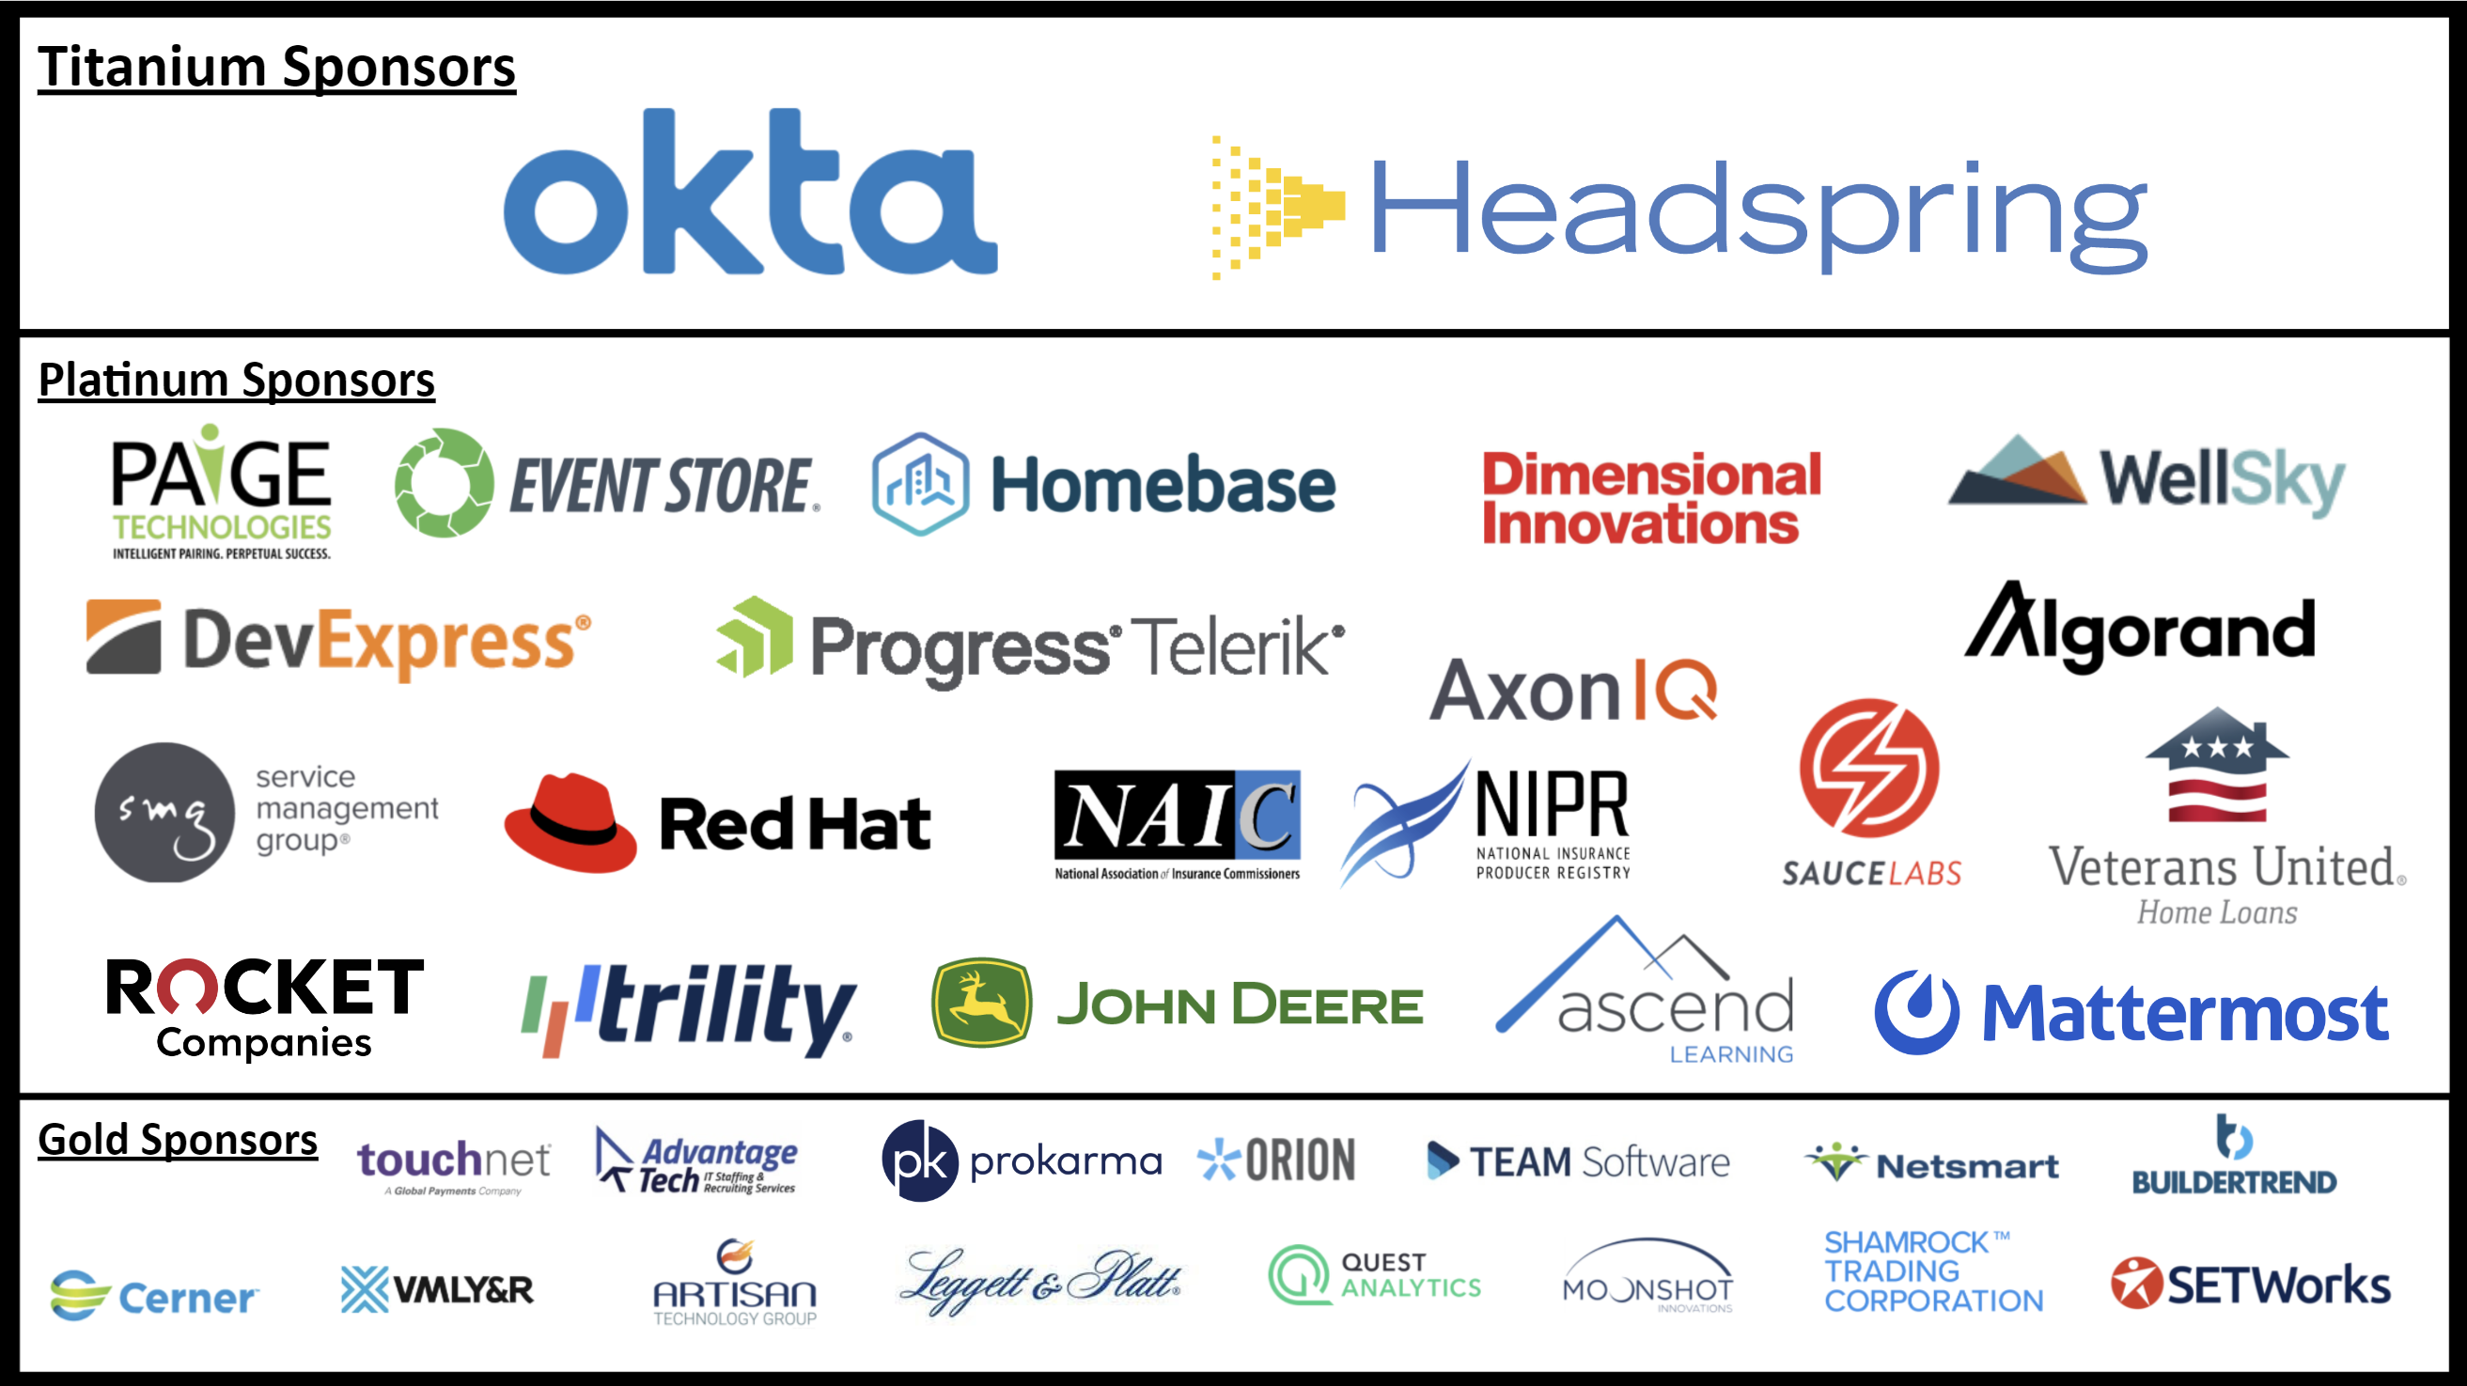

Slide 3

Audience
Existing .NET Developers
Desire for more maintainable solutons
scottsauber

Slide 4
Audience Goals
“New” perspective on a few topics
You’re not going to agree on everything
Take away some ideas to evaluate in your future workflow tomorrow
scottsauber

Slide 5


Who am I?
Director of Engineering at Lean TECHniques
Co-organizer of Iowa .NET User Group
Blog at scottsauber.com
scottsauber

Slide 6
Agenda
Lightning Talk approach
Talk about best practices for all these
Folder Structure
Don’t use IOptions Directly
Code Flow
Validation
ORM’s
Dependency Injection
Unit Testing and Assertions
DevOps
Feature Toggles
Microservices
scottsauber
Notes:
I find I get most bang for my buck getting a 5 min Lightning Talk from someone on a topic, so that’s what this is.
<after talking about all these> BINGO

Slide 7
Overall theme
Improve Maintainability
Better practices
Consistency
Enjoyable to work with
The point of software is to sustainably minimize lead time to business impact
“Legacy software is software you have no confidence in.”
scottsauber

Slide 8
Assumptions
I’m assuming you have a traditional LOB app without crazy volume
The answer is always “It Depends” but I’m going to throw that out the window and give some real guidance.
scottsauber

Slide 9
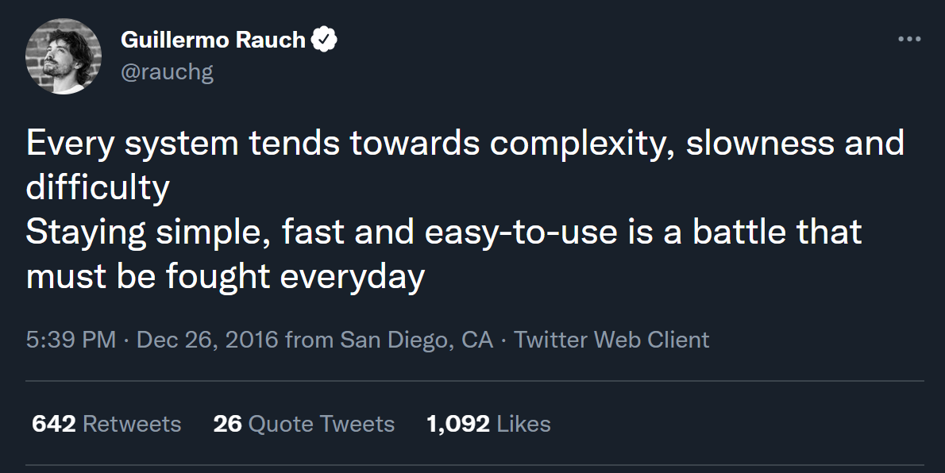

Slide 10
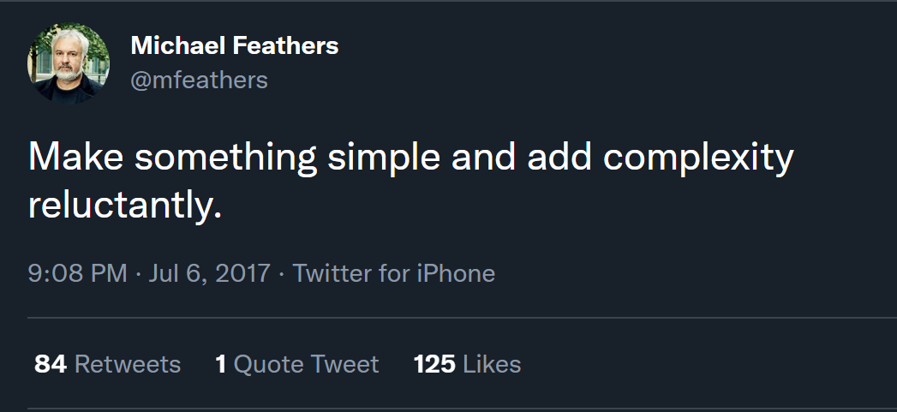

Slide 11
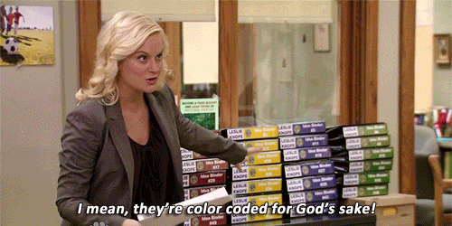
Folder Structure

Slide 12
Problem: OOB MVC Folders By Responsibility
All of these live in their own separate folders and most are required to add a new feature
Controllers
Views
Models
wwwroot/css
wwwroot/js
Adds navigation friction
Scope of a feature is scattered
Makes it hard to add, delete or extend existing features
scottsauber

Slide 13
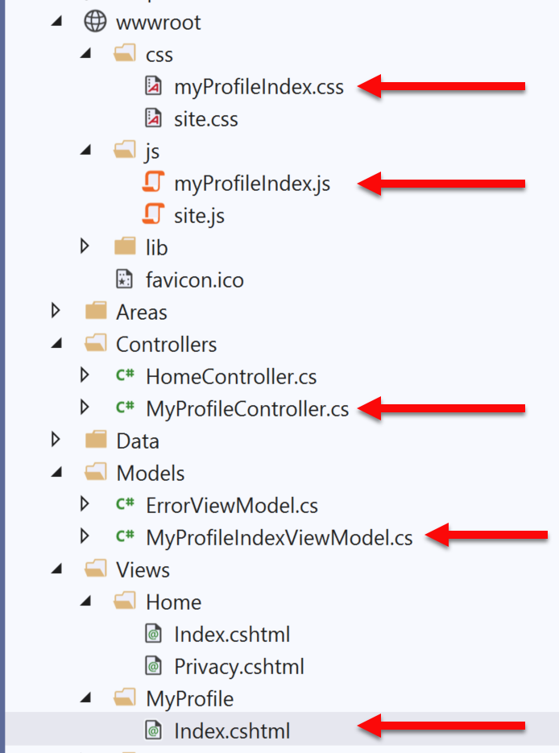
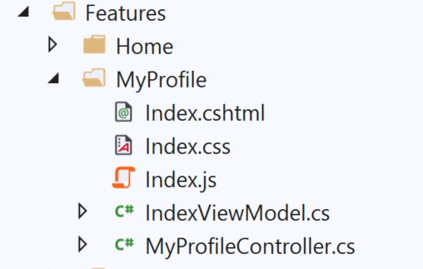
Solution: Use Feature Folders
Grouping by Feature, not by Responsibility, results in easier maintenance
Related things remain together (High Cohesion)
MVC out of the box:
Feature Folders:
Notes:
Some even put tests in their feature folders

Slide 14
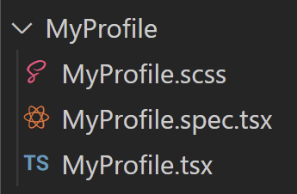
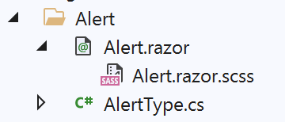
Solution: Use Feature Folders
React:
Blazor:
scottsauber
Notes:
Some even put tests in their feature folders

Slide 15
Feature Folder Extra Resources
How to do this in ASP.NET Core
My blog post
Steve Smith’s Blog on Feature Folders vs. Areas
Also used in React, Angular, etc.
Refactoring to Vertical Slice architecture (featureFolders++)
Derek Comartin
scottsauber

Slide 16
Questions on Feature Folders?
scottsauber

Slide 17
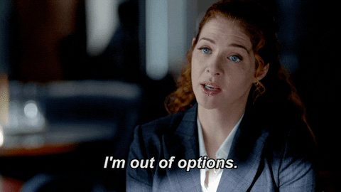
Don’t use IOptions… Directly

Slide 18
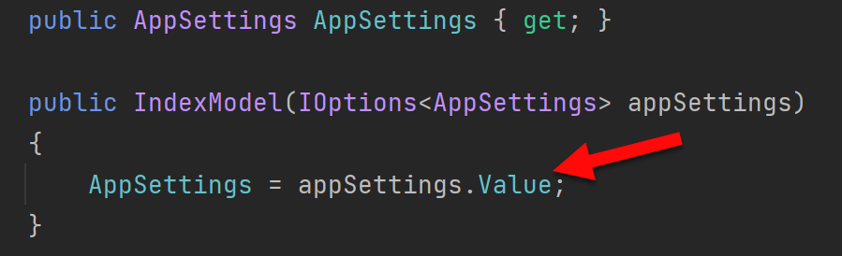
Problem: IOptions is annoying
Dependency on Microsoft.Extensions.Options down in other csproj’s
.Value everywhere adds friction
Testing IOptions is slightly annoying with Options.Create()
scottsauber

Slide 19
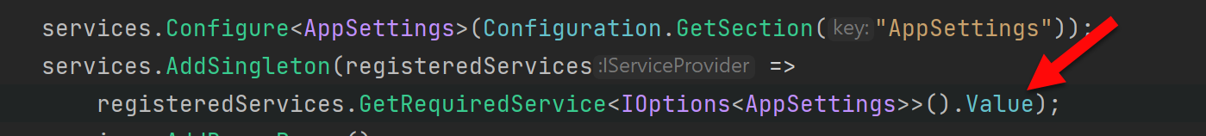
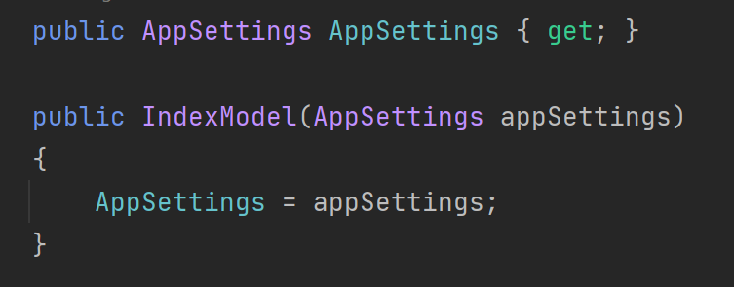
Solution: Register your Options class directly
scottsauber

Slide 20
Downside
Lose out on hot reloading configuration while app is running
Who really does that in modern apps anyways?
scottsauber

Slide 21
Questions on IOptions?

Slide 22
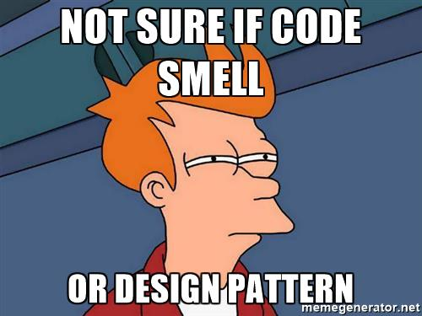
Code Smells

Slide 23
Structuring a method
Happy Path always at the bottom of the method
Don’t want to scan for “what happens when all goes well” and find it in the middle of a method
Use return’s instead of nested if => else
scottsauber

Slide 24
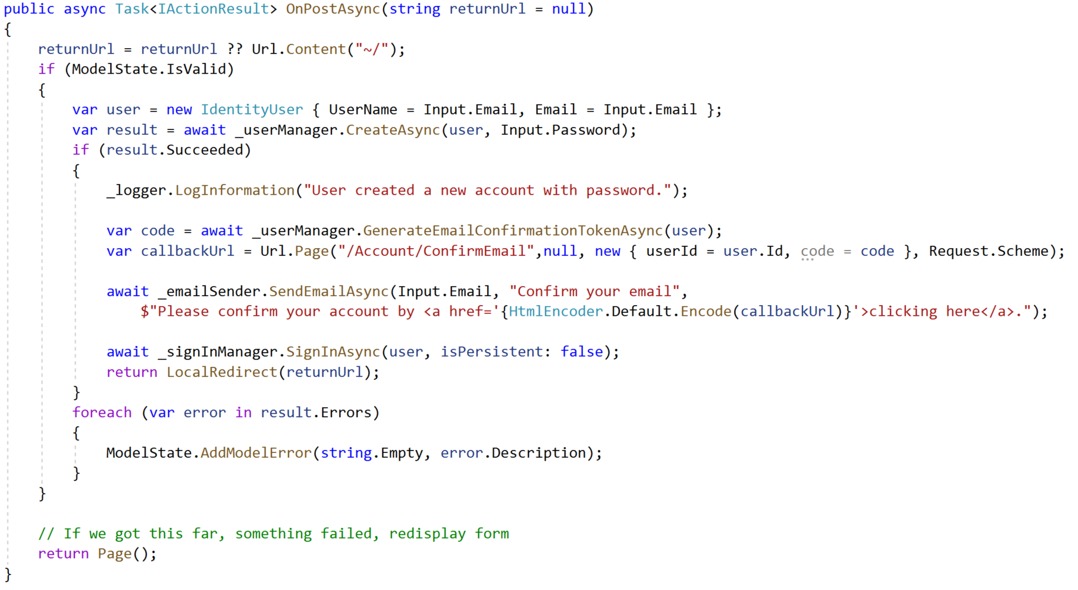
Razor Pages Template Code:

Slide 25
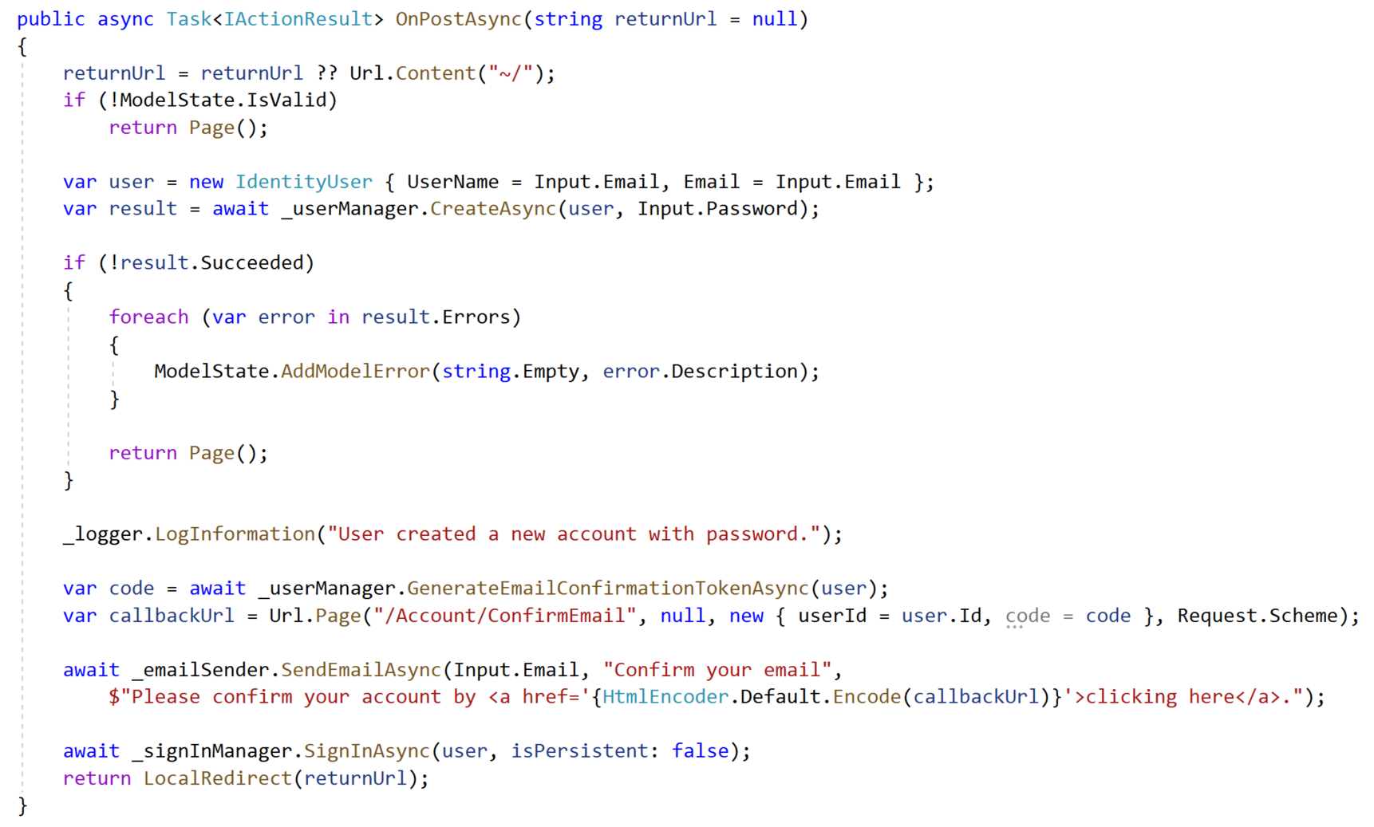
Refactored with Happy Path At The Bottom:

Slide 26
The Indentation Proclamation
The more indented your code is, the harder it is to follow
Nested if’s, nested loops, etc.
…I made this up
scottsauber

Slide 27

Code smells
Not hard and fast rules, just my “warning light”
Methods > 20 lines
Classes > 200 lines
Regions
You probably should’ve added a new class or method instead

Slide 28
Questions on Code Flow/Smells?

Slide 29

Validation

Slide 30
Validation – What’s wrong with OOB Options
Data Annotations
Only work well for simple scenarios
Hard to make custom ones
Hard to unit test
Separate annotations for each property
Can get “tall”
SRP violated
Model + Validation combined into one class
Writing own Custom Validation classes
Lose client-side hooks Data Annotations provides
scottsauber
Notes:
Data Annotations don’t scale for large application

Slide 31

Solution: Use FluentValidation
Fluent interface
Business rules are easy to maintain and read
Easy to show a stakeholder
Easy to test
Integrates with ModelState.IsValid
Same Client-Side validation as Data Annotations
95M downloads
https://github.com/JeremySkinner/FluentValidation
scottsauber

Slide 32
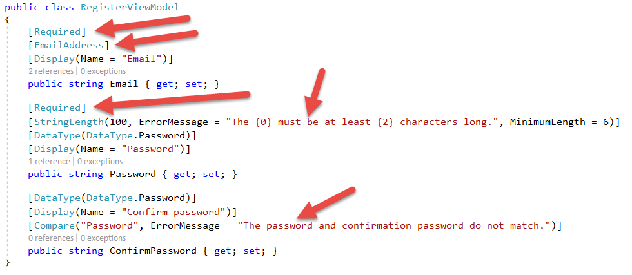
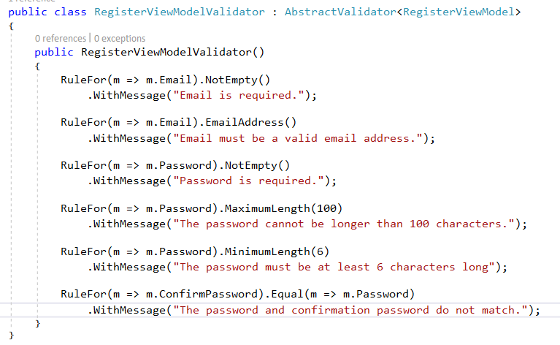
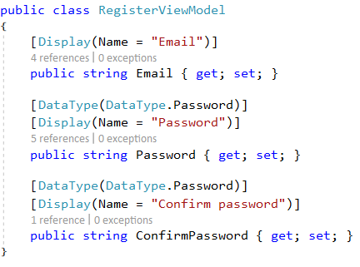
Template Code:
Refactored with Fluent Validation:

Slide 33
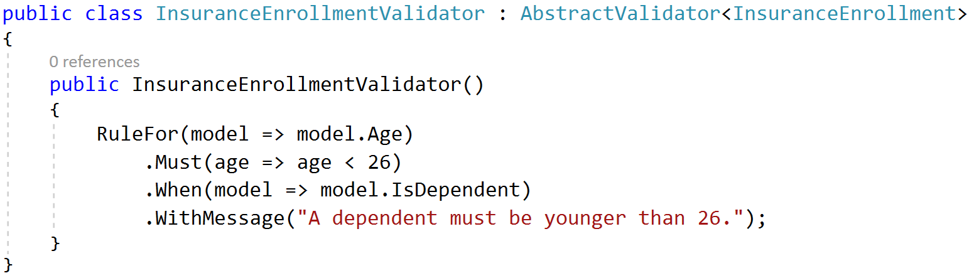
A Rule that only exists if….

Slide 34
Questions on Fluent Validation?

Slide 35

ORM’s

Slide 36

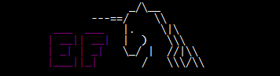
Don’t use raw ADO - Use an ORM
Entity Framework – Full ORM
Pros
Developer Productivity
Compile-time safety with LINQ Queries
Extremely quick to add new CRUD operations
Built in Unit of Work
Migration support
Cons
Less performant
Less control over the queries generated
Heavier
Dapper – Micro ORM
Pros
Performance near ADO
More control over the queries
Extremely simple to setup
Stack Overflow beta tests
Cons
SQL strings = Big column name refactorings are harder
Less features than EF
Notes:
Using an ORM will help you map to objects, which will help you make your view models

Slide 37
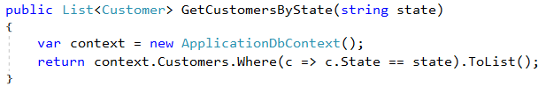
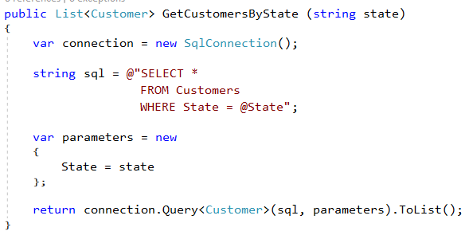
ORM usage comparison
Entity Framework:
Dapper:
Notes:
Obviously would want to inject in a SQL Connection or a DbContext here, not new up inline. But just showing you the objects both interact with. EF with DbContext and Dapper with SQL Connection.
Both manage connection life times for you. No more try/finally blocks.
Dapper more verbose and more to know about SQL, but you get better performance.
Both illustrate preventing

Slide 38
Other ORM things
Both manage connection lifetimes
Both give you SQL Injection protection
I use both depending on the job
DON’T WRITE YOUR OWN ORM
scottsauber

Slide 39
Questions on ORM’s?

Slide 40

Dependency Injection

Slide 41
Dependency Injection and IoC containers
DI/IoC helps you loosely couple your apps
Easily swap out different implementations
Switching directions
Running locally vs in the Cloud
Lets you unit test anything if done correctly
I use Microsoft.Extensions.DependencyInjection
Scrutor for auto-registration
scottsauber

Slide 42
Common DI Pitfalls
“New Is Glue”
“Static Cling”
DateTime.Now (and variants)
Instead inject in IClock or have method take in DateTime? and default to Now
HttpContext
IHttpContextAccessor in ASP.NET Core
ConfigurationManager in ASP.NET 4.x
Instead, inject a POCO Settings class
scottsauber

Slide 43
Questions on Dependency Injection?

Slide 44

Automated Tests

Slide 45
Automated Testing with xUnit
You should be writing automated tests
Exposes holes in your architecture
Proven to be faster long-term
Make changes quickly and confidently because have a regression test suite
Use xUnit or NUnit
Just not MSTest which is wayyy more verbose and has less features
xUnit used by ASP.NET team
I used to use NUnit and switched to xUnit
NUnit more boilerplate
No [TestFixture] in xUnit
No [SetUp] method just use a constructor in xUnit
scottsauber

Slide 46
Problem: OOB Assertion Libraries Annoy Me
Assert.Equal(value, value)
Hard to remember that it’s Assert.Equal(expected, actual)
Can lead to funky looking assertion failures if you flip them
No “Because” string in xUnit’s assertions
scottsauber

Slide 47
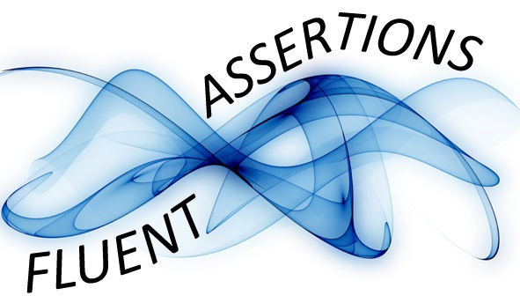
Solution: Use FluentAssertions for assertions
Adds a Should() extension method to object
result.Should().Be(0);
Easier to read than Assert.Equal(0, result);
Because string to explain why
can12YearOldDriveResult.Should().Be(false, “because you must be 16 years old to drive.”)
Should().BeEquivalentTo();
actualCustomer.Should().BeEquivalentTo(expectedCustomer);
100M+ downloads
scottsauber

Slide 48
Questions on Automated Testing?

Slide 49
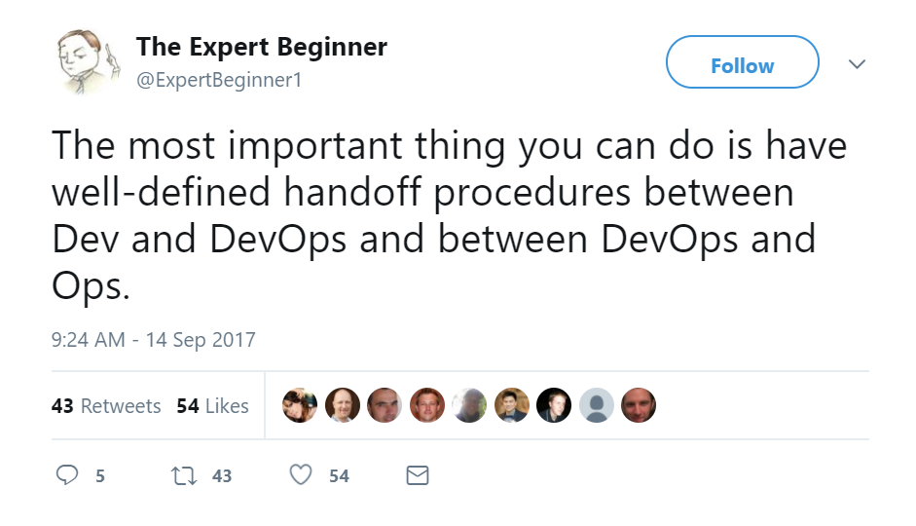
DevOps

Slide 50
What is DevOps
“DevOps is the union of people, process, and products to enable continuous delivery of value to our end users.”
- Donovan Brown

Slide 51

DevOps Pipeline

Slide 52
Continuous Integration and Delivery
Continuous Integration is a practice not a server
Build Server
Automated builds running on an independent build server
Automatically running automated tests
Creates an artifact
Continuous Delivery
Takes the artifact from the build server and deploys it
Go through different environments
Automated configuration of VM, IIS, folder permissions, Azure AppService, etc.
These two together will be transformational for you and your company
scottsauber

Slide 53
CI + CD enables
Consistency
Machine repeats the same steps over and over again
Consistency promotes Confidence
Passes build
Passes automated tests
Let’s deploy it to Prod!
Confidence enables agility
Mid-day deployments are no big deal
For a single app, the most I’ve seen for 2 developers is 24 deployments to Prod in 1 day
scottsauber

Slide 54
Questions on DevOps?

Slide 55

Feature Toggles

Slide 56
Feature Toggles
No long lived branches
No environment branches
Trunk Based Development
Commit to main instead!
Behind an if statement
Reduce merge conflicts
Simplest way: config files – Microsoft.FeatureManagement
appsettings.{Environment}.json
Commit to cleaning up after it’s live
De-couples deployments from releases
scottsauber

Slide 57
Questions on Feature Toggles?

Slide 58
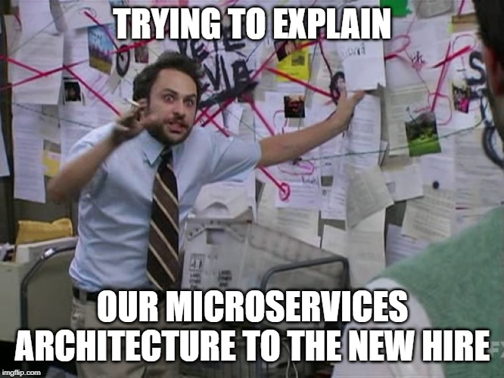
Microservices

Slide 59
What do I mean by microservices?
When I say Microservices I mean some out of process call of some sort (web service, queue, etc.)
scottsauber

Slide 60
Microservices Add Operational Complexity
Health Checks
Is it running? Are the dependencies ok?
Service Discovery (via Consul or something simple like config files with primary/backup)
Perf is worse
Traceability with Correlation ID’s
scottsauber

Slide 61
Microservices Add Development Complexity
HTTP call (most likely) instead of a method call
If calling from C#, likely want a client library wrapper around HttpClient sending JSON
Dev environment needs multiple projects running
Cross-cutting things (users, logging, common package versions, etc.)
Network boundaries don’t magically make your code better
Did you draw the right domain boundaries?
scottsauber

Slide 62
It’s not all bad…
Benefits
Iterate on microservices separate from other app (SRP)
Reuse
Scale independently
Easy to reason about in small chunks
You are not Google/Facebook/Netflix/Amazon
Use where it makes sense:
Needs scale
High CPU usage
Isolate an annoying dependency
Separate teams
Hard costs is a priority over engineering costs

Slide 63
My favorite definition of Microservices
“Loosely coupled service oriented architecture with bounded contexts.”
- Adrian Cockroft

Slide 64
Boundaries Boundaries Boundaries
“Almost all the successful microservice stories have started with a monolith that got too big and was broken up Almost all the cases where I've heard of a system that was built as a microservice system from scratch, it has ended up in serious trouble.” – Martin Fowler
“I remain convinced that it is much easier to partition an existing, "brownfield" system than to do so up front with a new, greenfield system.” – Sam Newman

Slide 65
Questions on Microservices?

Slide 66

BONUS

Slide 67
Bonus 11th Opinion
Build/Compiler warnings don’t exist in my world
Error or Nothing
scottsauber

Slide 68
Real benefits of these practices
1 web app went from deploying to Prod 20x a year to deploying to Prod over 500x a year
Faster delivery of value to users
scottsauber

Slide 69
Closing
Hope you got at least one idea out of this.
You likely don’t agree with everything I just said.
Focus on what matters
xUnit vs NUnit – who cares?
Why over How
scottsauber

Slide 70
Questions?
Slides up at scottsauber.com
scottsauber

Slide 71
Thanks!
Slides up at scottsauber.com
scottsauber

